Slide 1
Language Preliminaries
CMSC 330 Programming Languages

Slide 2
Why study programming languages?
Write clearer, safer, and more efficient programs
Learn and evaluate new (parts of) languages more easily
Choose the right language for a given problem
Increased capacity to express ideas
Better understanding of the significance of implementation

Slide 3


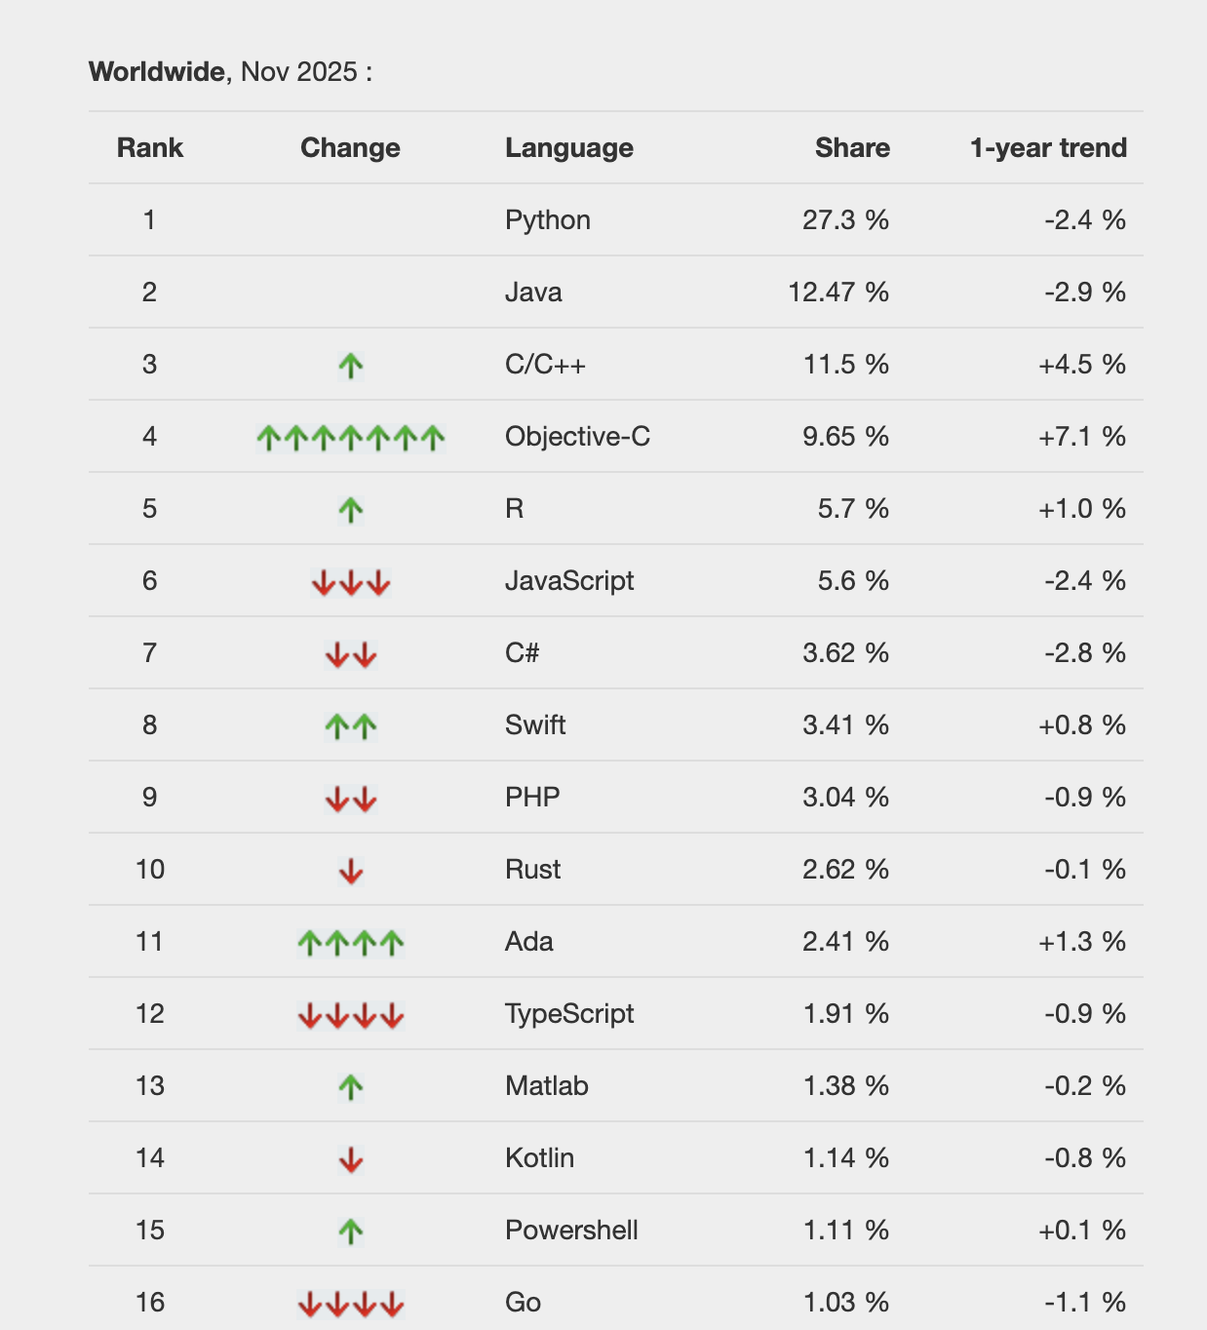
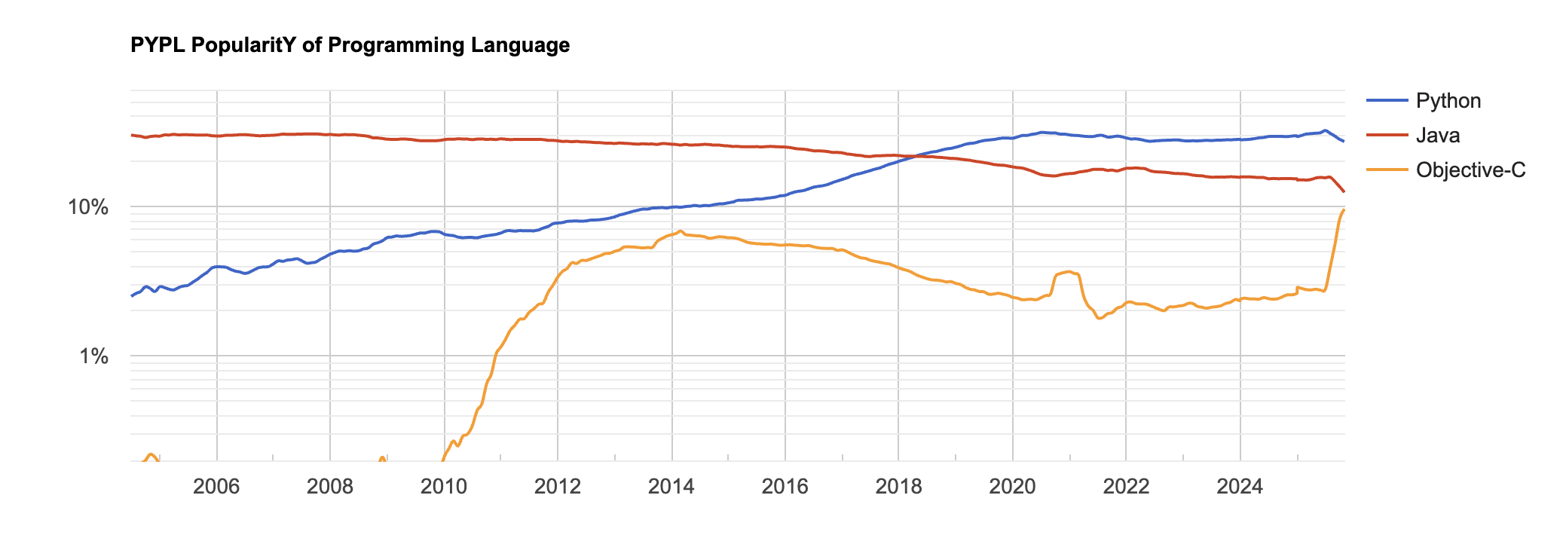


Slide 4
What is a language?
What are primary components of a language?
Words (vocabulary)
Syntax (grammar)
Semantics

Slide 5
In Computer Science
Language: a system of tokens (i.e., word categories) and rules for combining them into code
What types of tokens do we use?
What rules do we use?

Slide 6
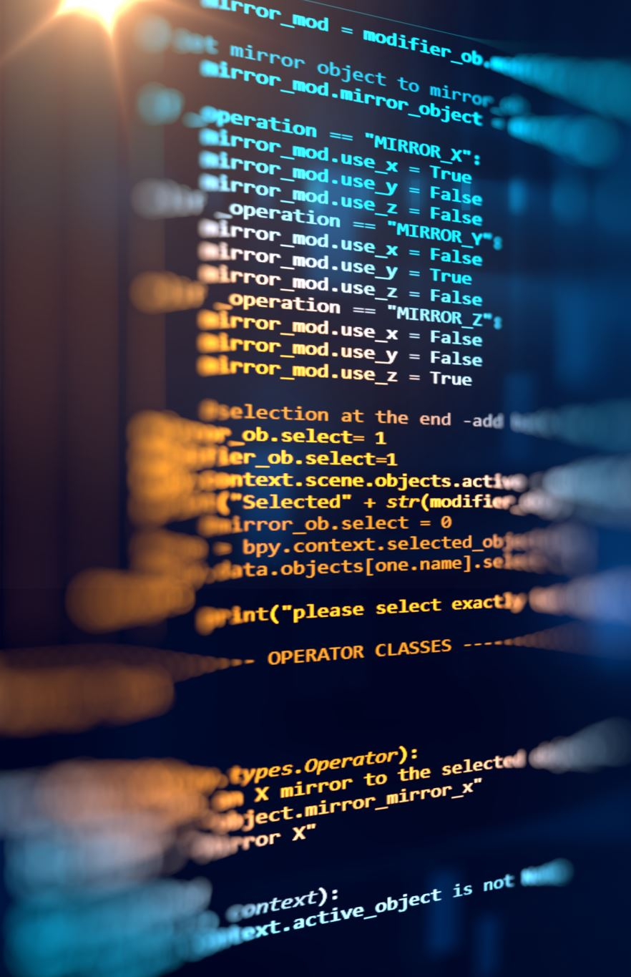
Token
In programming languages, a token is a basic unit of code (a word, number, or symbol)
Tokens can appear in different orders; some have special meaning
Common types: alphanumeric, numeric, or symbolic
Examples in Java / C++:
Keywords, Identifiers, Literals, Operators, etc.

Slide 7
Keywords
Keywords are a type of token
Usually reserved by the language
Only be used in specific locations
Examples?

Slide 8

Symbols
Symbols are another type of token
Usually combinations of punctuations (non-alphanumeric) characters
Often used for operators
Also serve as punctuation (e.g., ;)
Examples? == in Java, << in C++

Slide 9
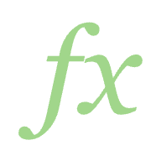
Identifiers
Identifiers refer to specific entities of a program
The name of a variable, function, …
What other things can we name?
Examples
Math.sqrt, java.util.Scanner

Slide 10
Literals
A literal is a notation for representing a fixed value directly in the source code.
It represents data itself, not a variable or expression.
Examples:
42, “Hello World”, ‘a’, TRUE, FALSE

Slide 11
Rules in Language Design
Tokens are combined according to formal rules.
Two main types of rules:
1. Syntactic Rules – define the correct structure of token sequences (grammar)
2. Semantic Rules – define the meaning and type correctness of token sequences

Slide 12
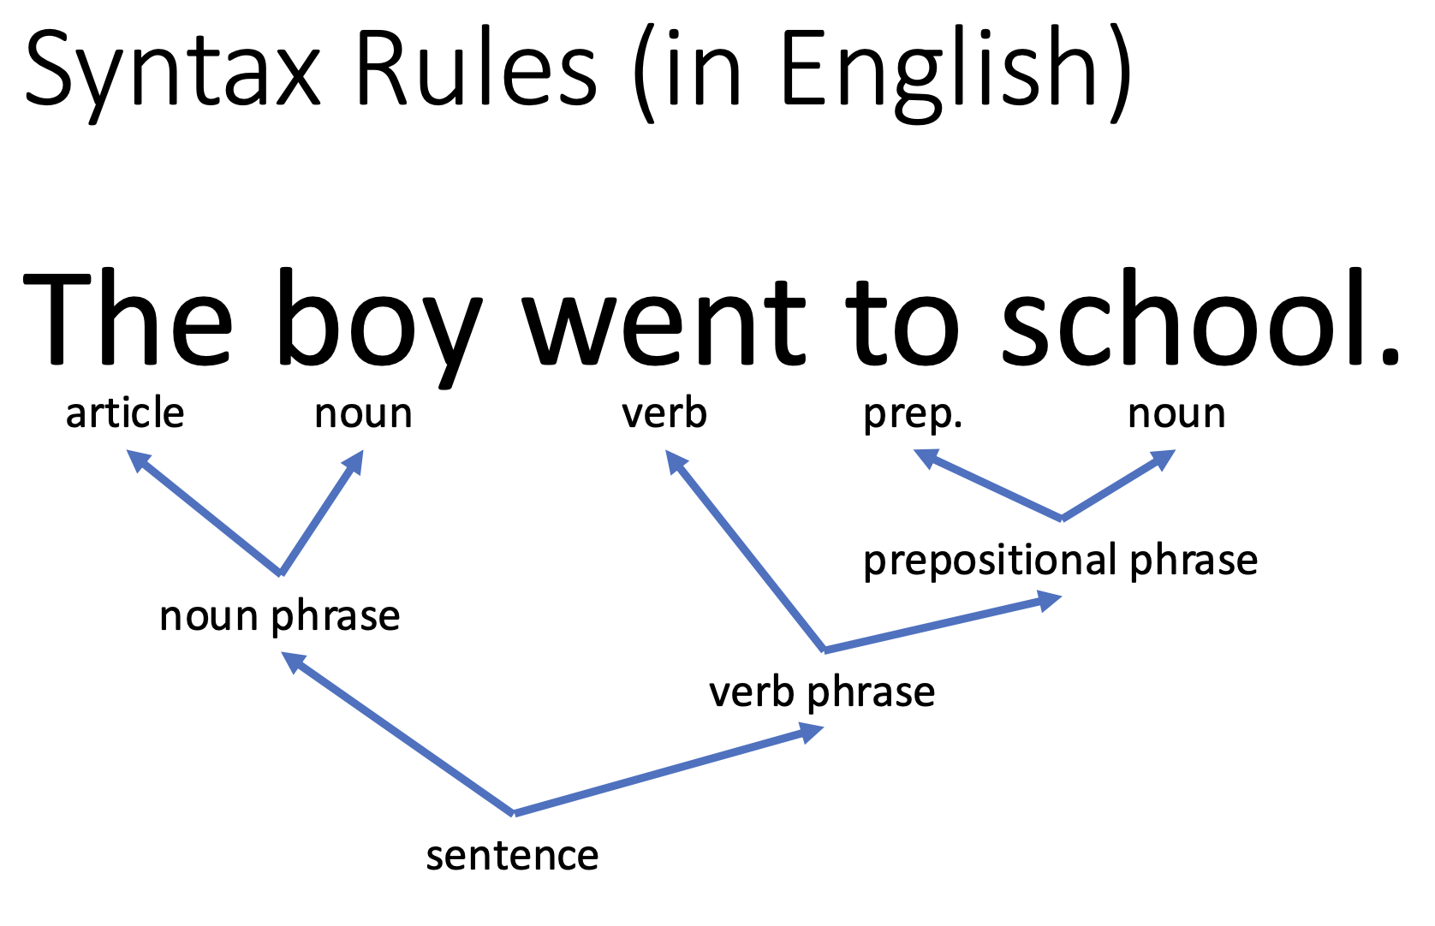

Slide 13
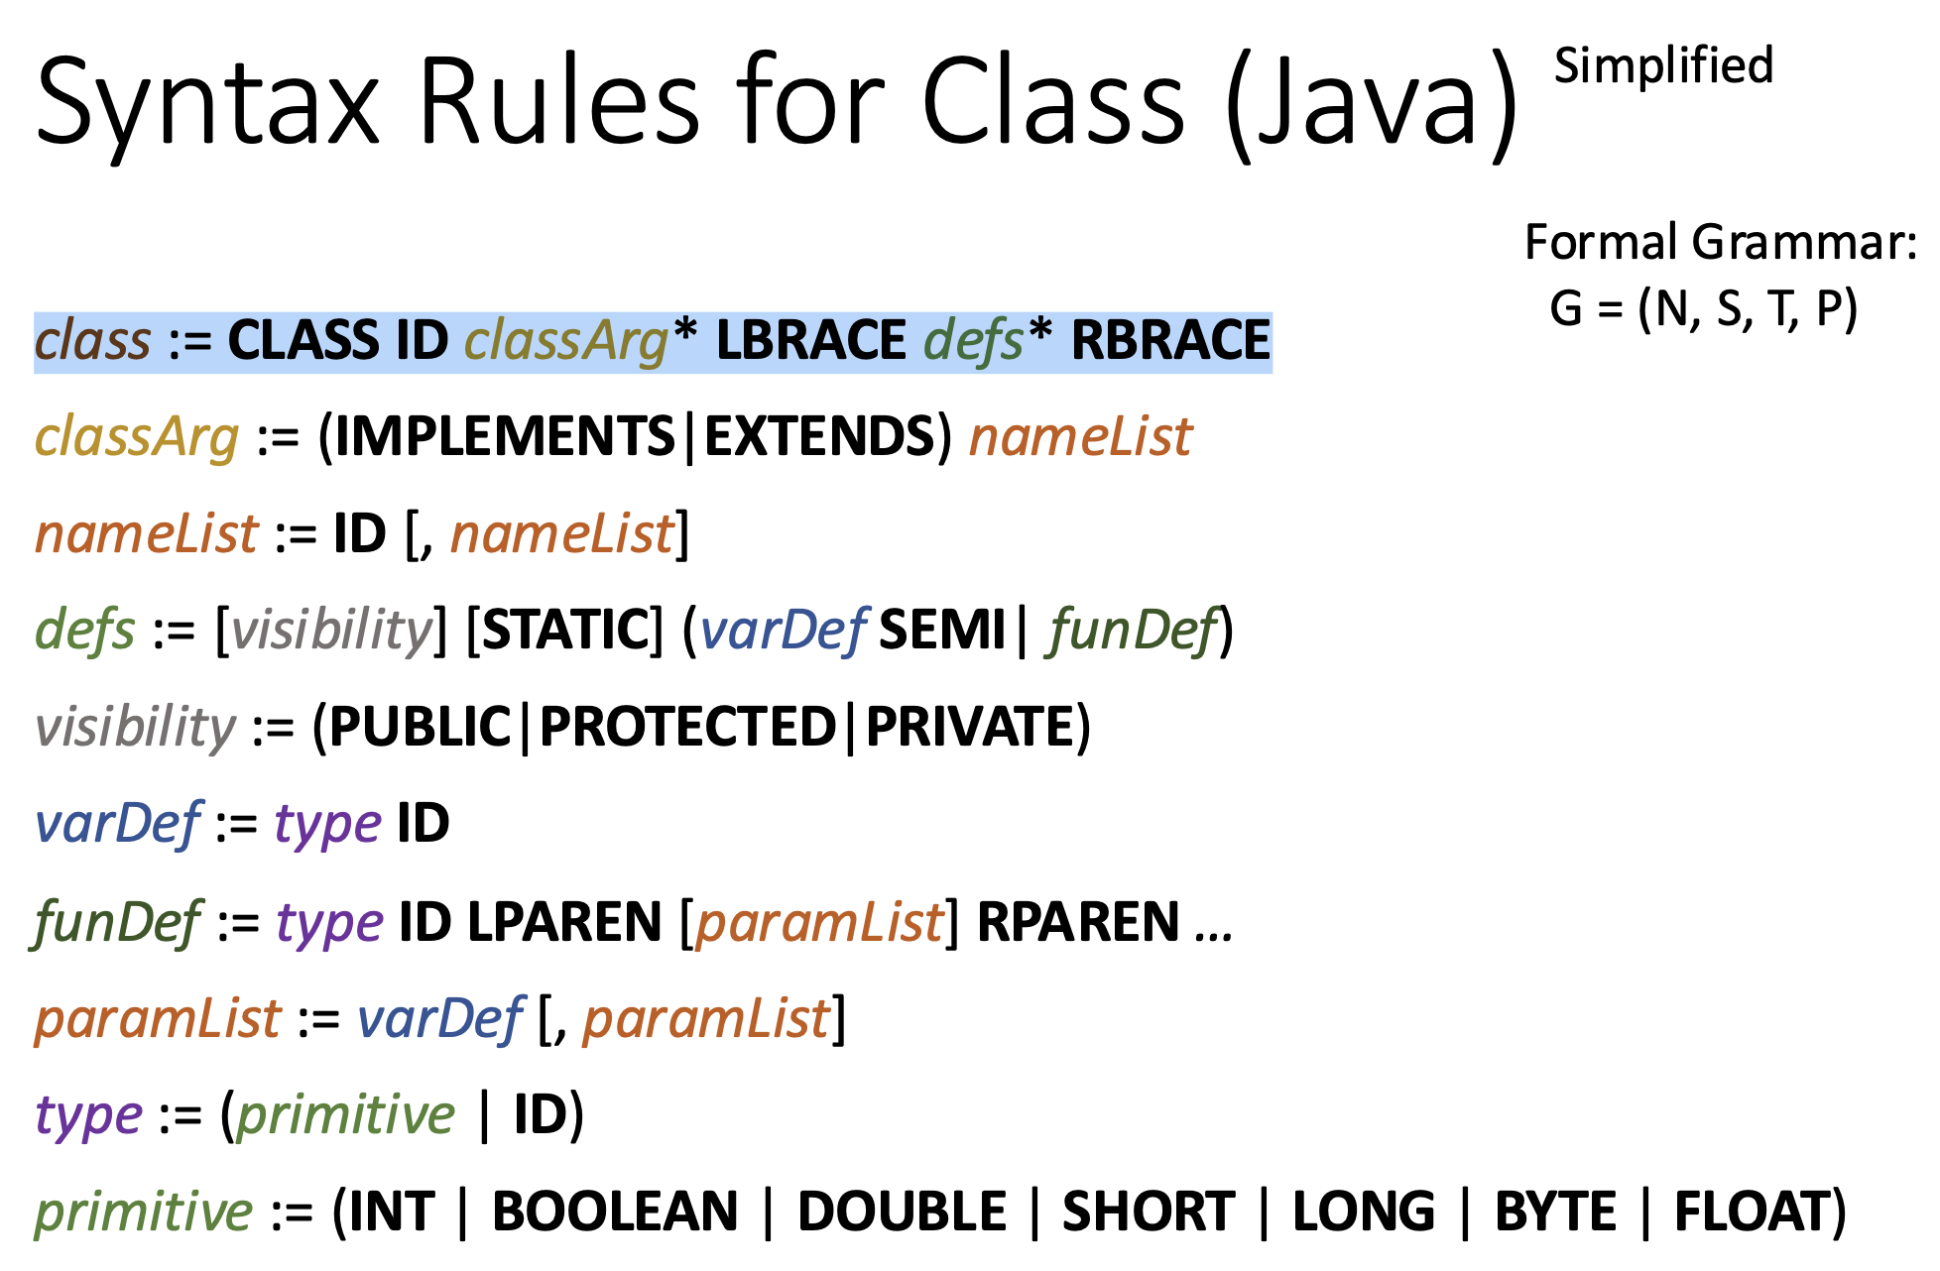

Slide 14
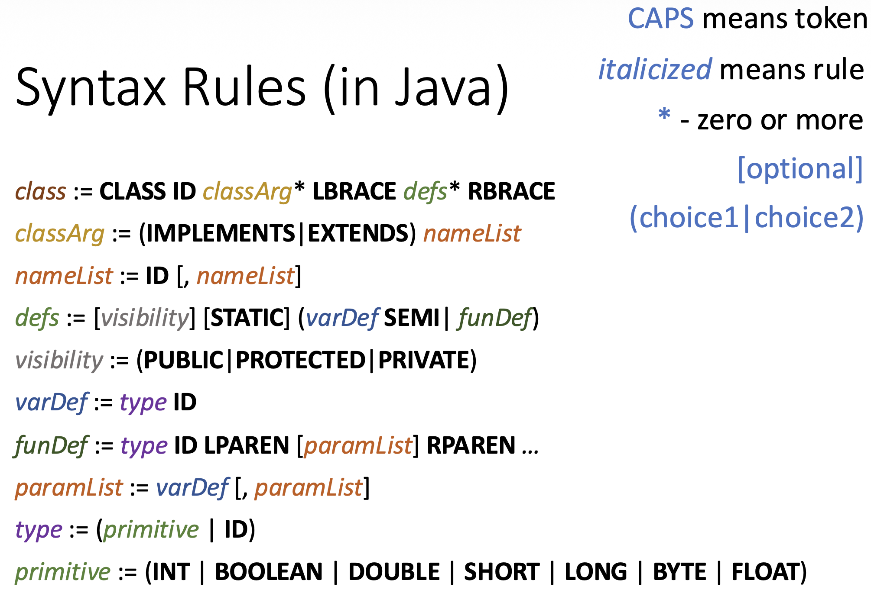

Slide 15
In this example
What are the tokens?
Where are the rules?
Exercise: Make a “Point” Class with two public members of type double, named x and y.

Slide 16
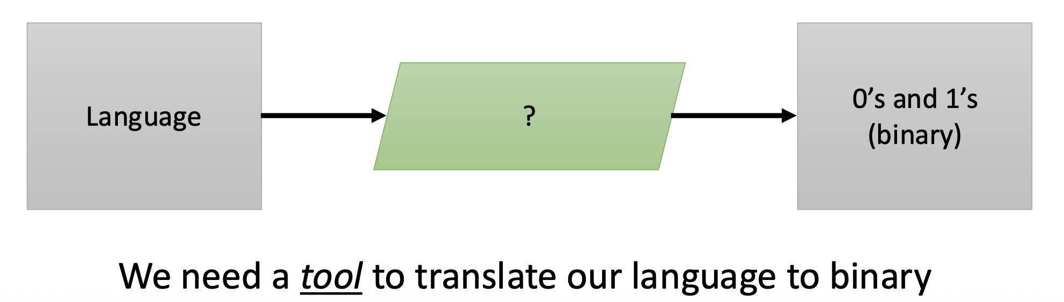
Language Transformation
Computers "understand" binary machine code
See: Computer Architecture
Humans do better with high-level languages
See: Programming Languages

Slide 17
Compilers
Input:
Source program written in a well-defined, unambiguous programming language
Output:
Target code (machine code, bytecode, or another language)
Task:
Translate the source program into the target language
Preserve observable behavior – the externally visible effects of the program, such as:
Output to screen/console
Returned values
Changes to files, databases, or network resources
Modifications of global or shared state

Slide 18
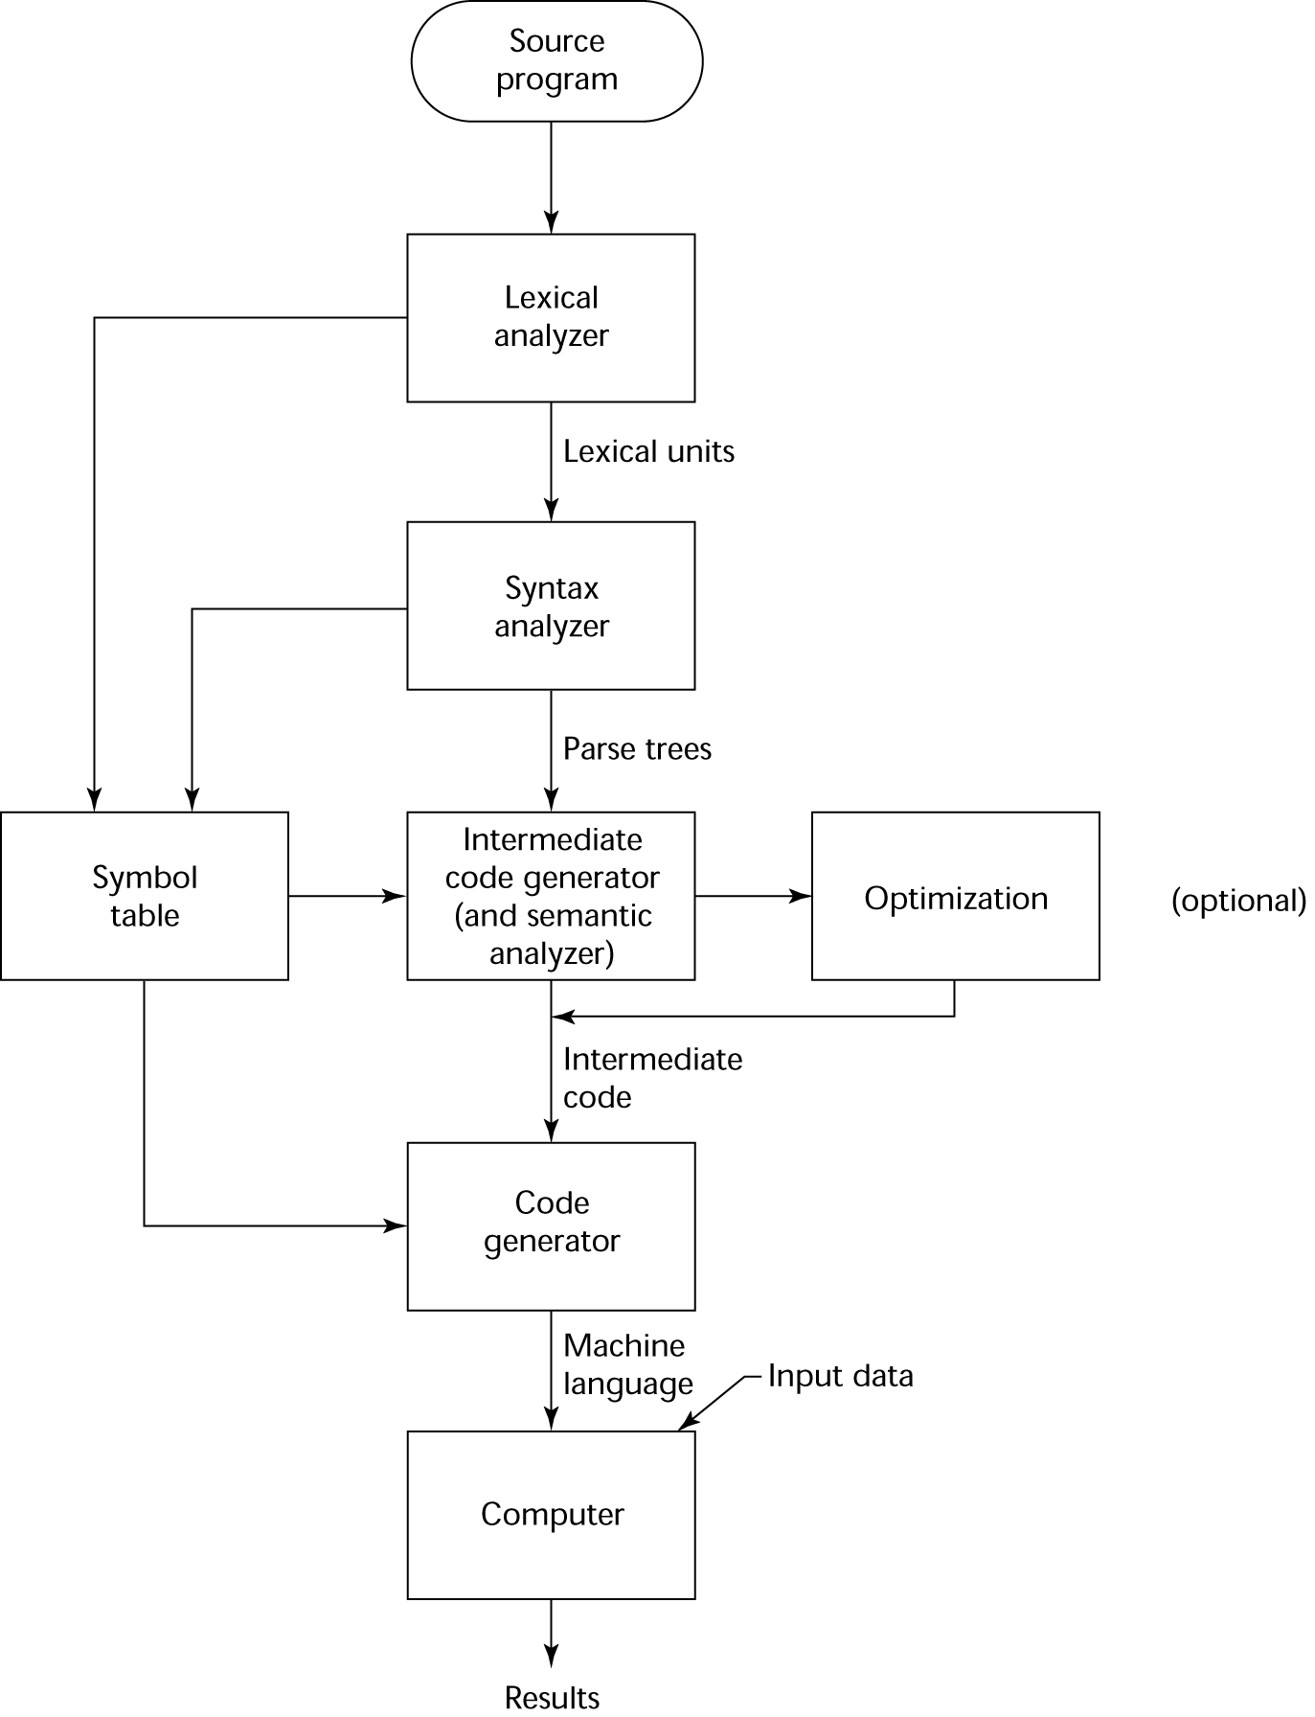
The Compilation Process

Slide 19
Interpreters
Input:
Source program written in a well-defined, unambiguous programming language
Output:
Direct execution of the program’s instructions; usually no separate target code is produced
Task:
Execute the program line by line (or statement by statement)
Preserve observable behavior

Slide 20
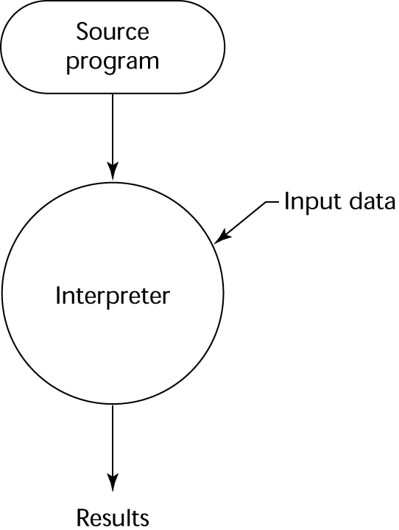
Pure Interpretation Process

Slide 21
Classes of Programming Languages
Imperative / Procedural
Specify how to perform tasks step by step
Object-Oriented (OO)
Organize code around objects with data and behavior
Functional
Focus on functions and expressions, avoid changing state
Logic / Declarative
Specify what to achieve, not how to do it

Slide 22
The First Programming Language
What year do you think the first programming language was developed?
What did it look like?
What machines was it used for?

Slide 23
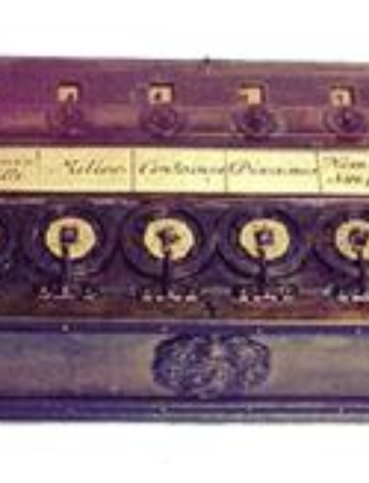
Early Calculators and Mechanical Machines
1. Blaise Pascal (1642)
Invented the Pascaline at age 19
Gears and cranks to automate addition & subtraction
Mechanical calculator, not programmable
2. Wilhelm von Leibniz (1670s)
Stepped Reckoner
Could perform all 4 arithmetic operations
Still a mechanical calculator, limited function

Slide 24
From Ada Lovelace to High-Level Programming
Charles Babbage
Difference Engine (1820s) – automatic table calculation
Analytical Engine (1837) – first concept of a general-purpose programmable machine (never fully built)
Features: memory (store), CPU (mill), loops, conditional branching
Ada Lovelace (1815–1852)
Collaborated with Babbage on the Analytical Engine
Wrote the first algorithm (Bernoulli numbers)
Recognized programming potential beyond numbers

Slide 25
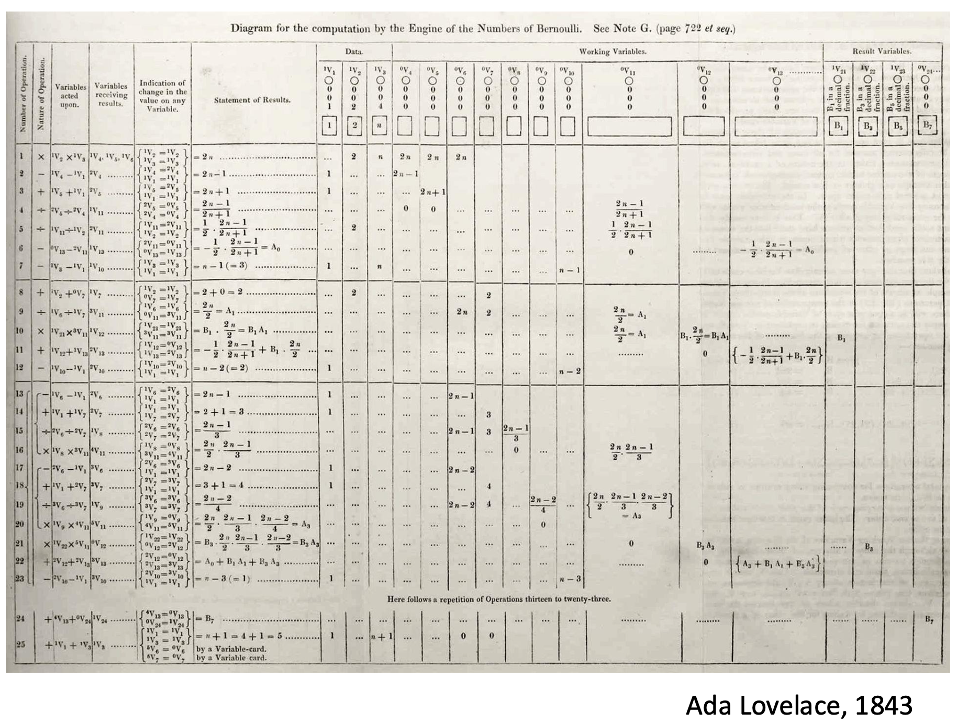
The First Program

Slide 26
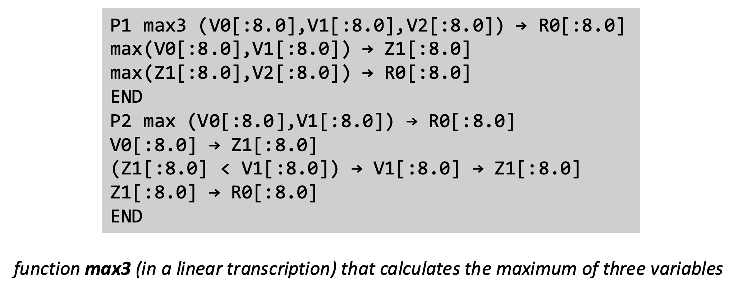
First High-Level Programming Language
Plankalkül (Plan Calculus, 1943-1945)
Konrad Zuse

Slide 27
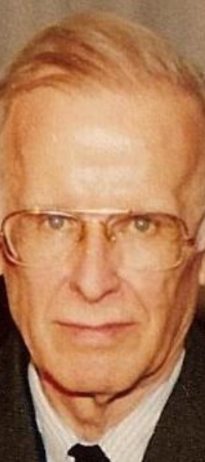
First Commercial Programming Language
Fortran (1954)
John Backus + IBM
"Much of my work has come from being lazy. I didn't like
writing programs, and so, when I was working on the IBM
701, writing programs for computing missile trajectories, I
started work on a programming system to make it easier
to write programs.”

Slide 28
History of Programming Languages
Split up into four groups:
Group 1: 1950 – 1979
Group 2: 1980 – 1994
Group 3: 1995 – 2009
Group 4: 2010 – Present

Slide 29
Next Class
Have each group discuss findings
Research AT LEAST the languages: Fortran, COBOL, Python, C++, Java, PL/I, Kotlin, Ada, Rust, C#, C, Basic, Lisp, Prolog, ML, Carbon, JavaScript, APL, Swift, Zig, Haskell; and Identify:
Classes, e.g., imperative, functional, etc
Language transformation methods, e.g., compiler, interpreter
Origin, e.g., research (Ph.D.), Industry (IBM, etc), Hobby
What was the language designed for? What languages seem most prominent?

